Slide 1
Movie recommendation system
Sprint 3 Julia, Martin, Iain

Slide 2
Sprint goals recap:
Progress on frontend
Tests
User authentication
Database
Clear documentation

Slide 3
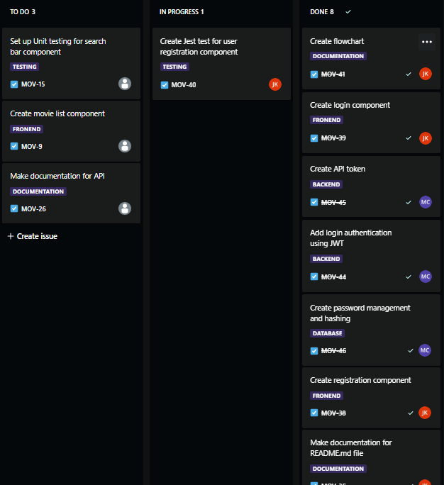
Demonstration of completed work:

Slide 4
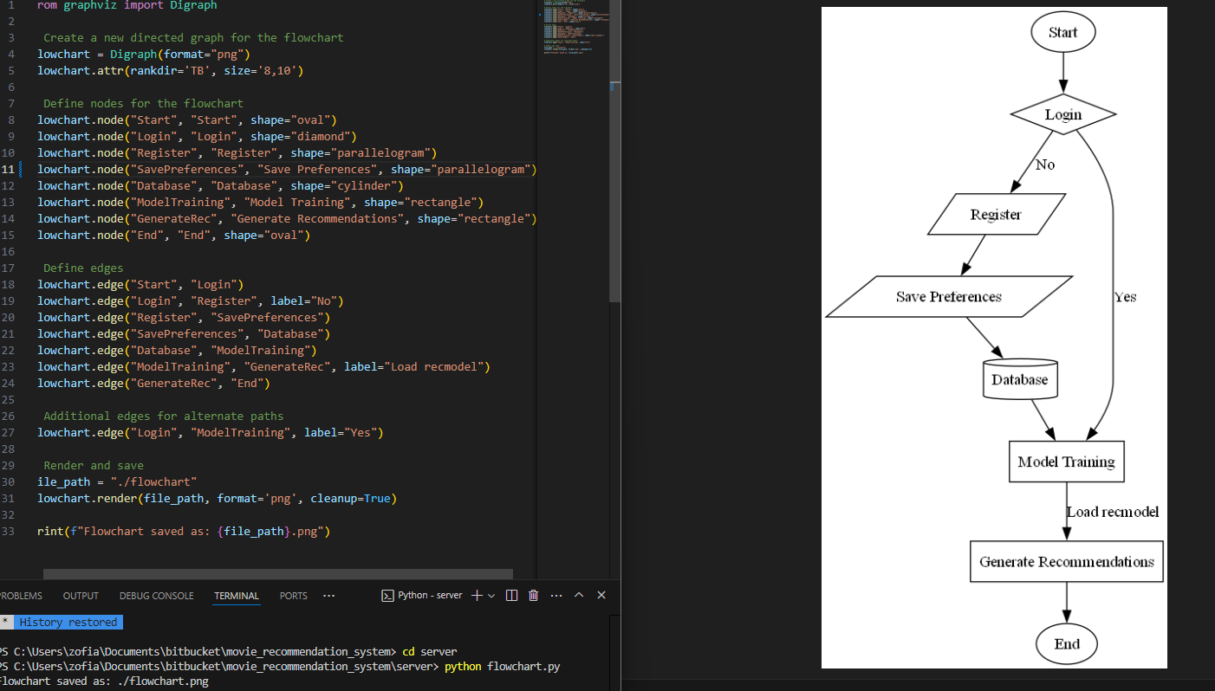
Flowchart:

Slide 5
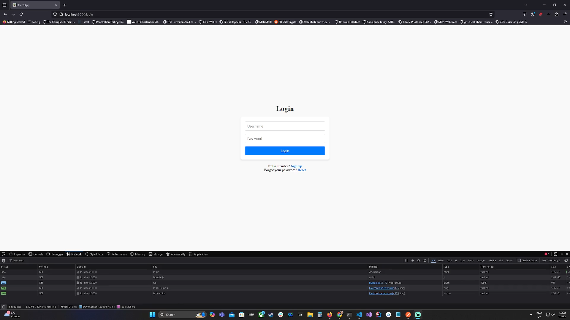
How it look like

Slide 6
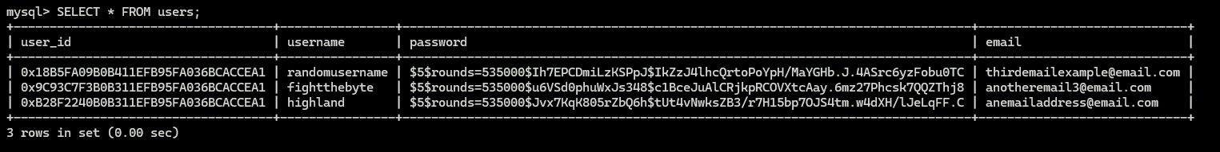
Database:

Slide 7
Our challenges
Learning how flask authentication works
Learning MySQL
Http request

Slide 8
Thank you
Presented by:
Julia – project leader, dev team
Martin – scrum master, dev team
Iain - dev team

